Slide 1
Civil Procedure
Class 1

Slide 2
Agenda
Introduction
What is civil procedure?
Anonymous Physician v. Wininger
Overview of the U.S. court system
Course logistics

Slide 3
I. Introduction

Slide 4
I. Introduction
Welcome!

Slide 5
Teaching team
Professor: Andrew Lanham
Tutors:
  Lainey Brown
  Justin Nguyen
  Emily O’Neill
  Christine Song
  Austin Trevino
  Sarah Williams

Slide 6
II. What is civil procedure?

Slide 7
Procedure vs. substance
Substance = the law governing what people are allowed to do (torts, contracts, property, etc.)
Procedure = the law governing how a court can enforce those substantive rules, i.e., the process for resolving cases

Slide 8
Civil vs. Criminal cases
Civil cases involve private parties or the government suing for a civil cause of action—such as contract or tort claims. The “plaintiff” sues the “defendant.”
Criminal cases involve the government prosecuting a defendant for breaking a criminal law. Criminal cases have their own procedures.

Slide 9
Sources of Procedural law
Federal Rules of Civil Procedure (FRCP)
State procedural rules
Statutes
Local court rules
The U.S. Constitution
Court cases

Slide 10
Procedure in everyday life
The Federal Rules of Civil Procedure can be technical and complex.
But we think about procedure and fairness all the time in everyday life. And good lawyers use everyday analogies to help explain the law.

Slide 11
Procedure in everyday life
I will bring in Halloween candy later in the semester
Substantively, we need to know what kind of candy I should buy
Procedurally: How should we choose what kind of candy I will buy?

Slide 12
Procedure in everyday life
Form groups of 3–5 in your area of the classroom,
And talk through the following questions:
  What would be the fairest way to decide?
  What process is most likely to yield the outcome that you want?
  What process should we use?

Slide 13


Slide 14
Some key Procedural Questions
Who decides?
How do they decide?
When do they decide?
Is that the right process? (normative or ‘policy’ question)

Slide 15
III. Anonymous Physician v. Wininger

Slide 16
Statute of Limitations
“limitations period” = how long the clock runs for
The clock begins running when the claim “accrues”
Plaintiff must start lawsuit within “limitations period”
Limitations period might be “tolled,” i.e. paused, depending on the context

Slide 17
Hypotheticals:
Imagine Wininger filed her claim on August 1, 2009. Would that be within the 2-year period? How about September 30, 2009?
Imagine that in Johnson, the plaintiff’s problem wasn’t from the surgery, but from a post-operative infection. When did the clock start to run?
Imagine you represent a medical insurance company. You bring a claim against A.P. alleging that they overcharged your company for 25 years. The statute of limitations is 4 years. How should it apply?

Slide 18
Key Questions for Every Case
Who are the parties? What court are they in?
What is the dispute? I.e., what are the facts of the case?
What is the procedural posture? I.e., what process has already occurred, and what procedural stage is the case at now?
What does the court decide?
How does the court decide? What is its reasoning?
Normatively, is this a good procedural rule?

Slide 19
IV. Overview of the U.S. Court system

Slide 20
State Courts and federal Courts
The states and the federal government each have their own civil litigation systems.
Each court system has its own procedural rules.
The Federal Rules of Civil Procedure have been very influential, so they provide a good way to learn procedural law. We’ll focus mainly on federal procedure.

Slide 21
Structure of the Federal Courts
U.S. District Courts—trial court
Circuit Court—court of appeals; 12 circuits
Supreme Court—highest court; decides which appeals from the Circuit Court it will choose hear (certiorari)

Slide 22
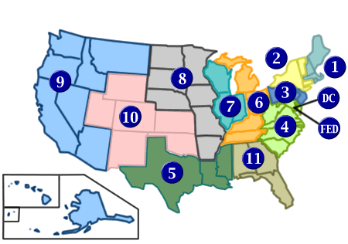
Federal circuits

Slide 23
U.S. Judicial system
U.S. Supreme Court
federal issues only
Court of Appeals
Supreme Court
Circuit Court
of Appeals
Supreme Court,
Appellate Division
Court of Appeal
Supreme Court
Superior Court
District Court
State Courts:
New York California Federal Courts

Slide 24
Texas state court system
https://www.txcourts.gov/media/1461638/court-structure-chart-dec-2025.pdf

Slide 25
V. Course Logistics
The syllabus is your guide.

Slide 26
Key Takeaways
Courts do not have general authority to resolve all disputes. Their powers are constrained by procedural limits.
So the procedures can be just as important as the substantive law in deciding who wins the case.
Good lawyering involves thinking strategically about how to navigate the procedural steps in the case. This class is about those procedural steps.
One limit is a statute of limitations: plaintiffs must sue within a certain amount of time after an injury occurs, though the time may be tolled.

